Slide 1
HireAC
YOUR HOW TO GUIDE

Slide 2
HireAC Guide Sections
Getting Started with HireAC
Cooperative Education Module in HireAC
Changing Preferred Name in HireAC
Downloading the Co-op Work Permit Confirmation Letter
Co-op Documents Page in HireAC
Co-op Job Postings Page in HireAC
Setting up Job Alerts in HireAC
Co-op Interviews Page in HireAC
Co-op Job Offers in HireAC
Co-op Work-term record in HireAC
Booking a Peer Review meeting in HireAC
Events And Workshops Module in HireAC
Career & Employment Module in HireAC

Slide 3
9. Co-op Job Offers in HireAC
How to review and respond to job offers in the Rankings page

Slide 4
Viewing and responding to Co-op job offers in HireAC
After an employer has completed interviews, they will rank their top candidates in HireAC. This means they list their top choices in order of preference—Rank 1 is their first choice, Rank 2 is their second, and so on.
The Co-op and Career Centre will extend offers through HireAC to the student(s) ranked as the employer’s top choice (Rank 1), following the job offer dates for each hiring round.
If selected, you will receive an email through your Algonquin Live account with your offer and will be directed to log into HireAC and respond to the job offer within 24 hours.

Slide 5
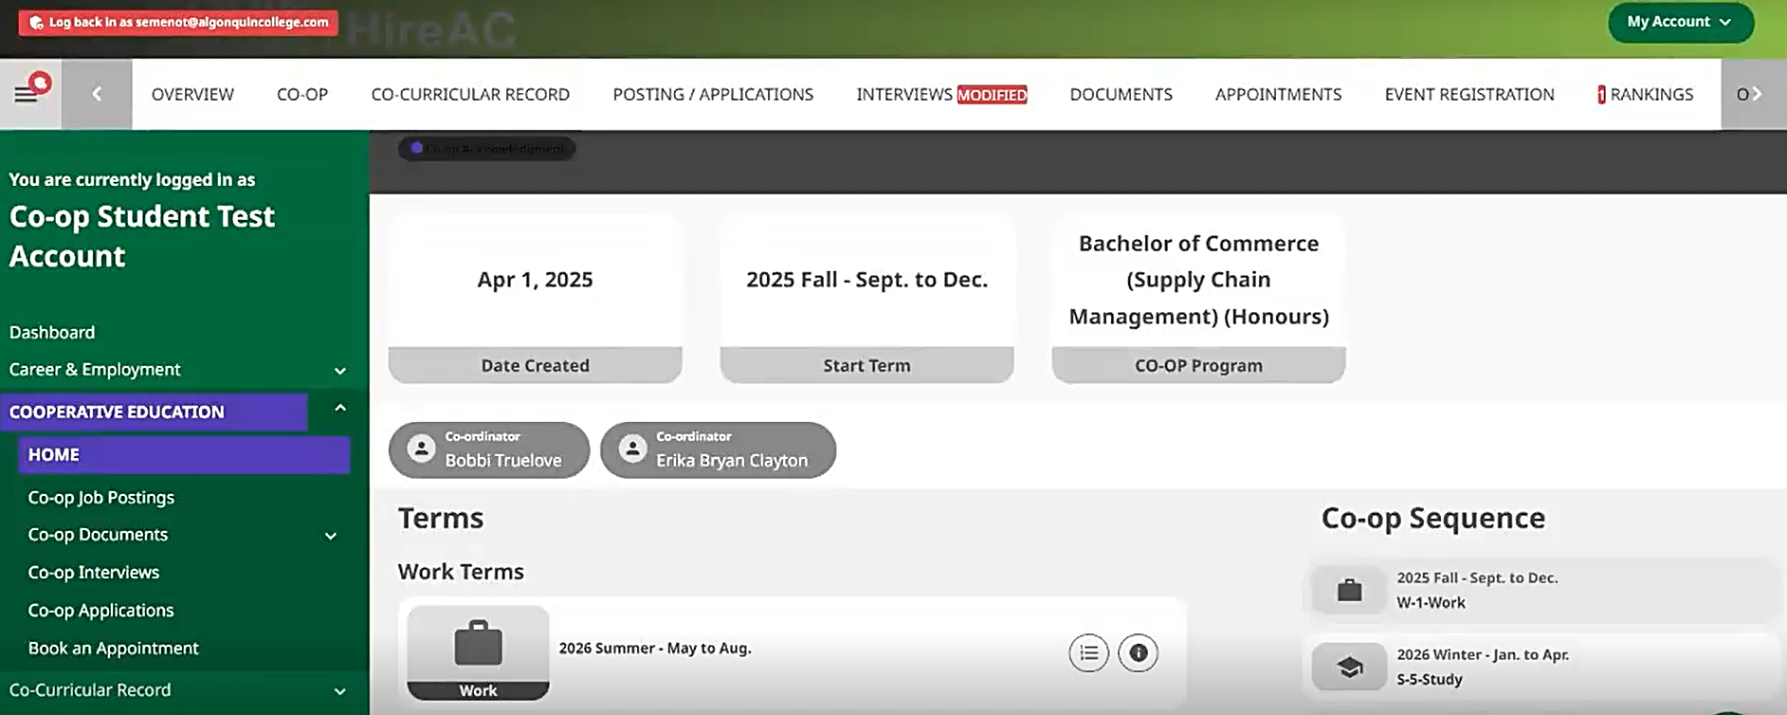
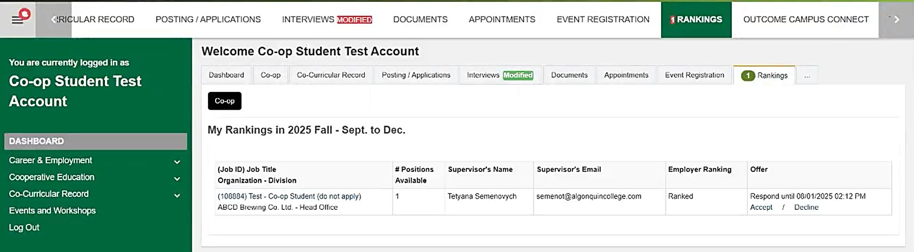
Rankings Page in HireAC
In HireAC, go to the Rankings page to access and review your Co-op job offers.
Use the horizontal menu at the top of the page to access this section. If a job offer is available, it will be indicated by a number next to the Rankings page label
You will be able to review the job description, supervisor name and email as well as the deadline to respond to the offer on the Rankings page.

Slide 6
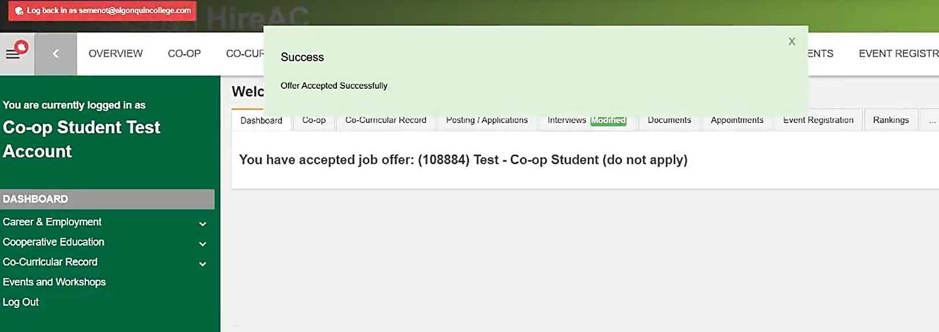
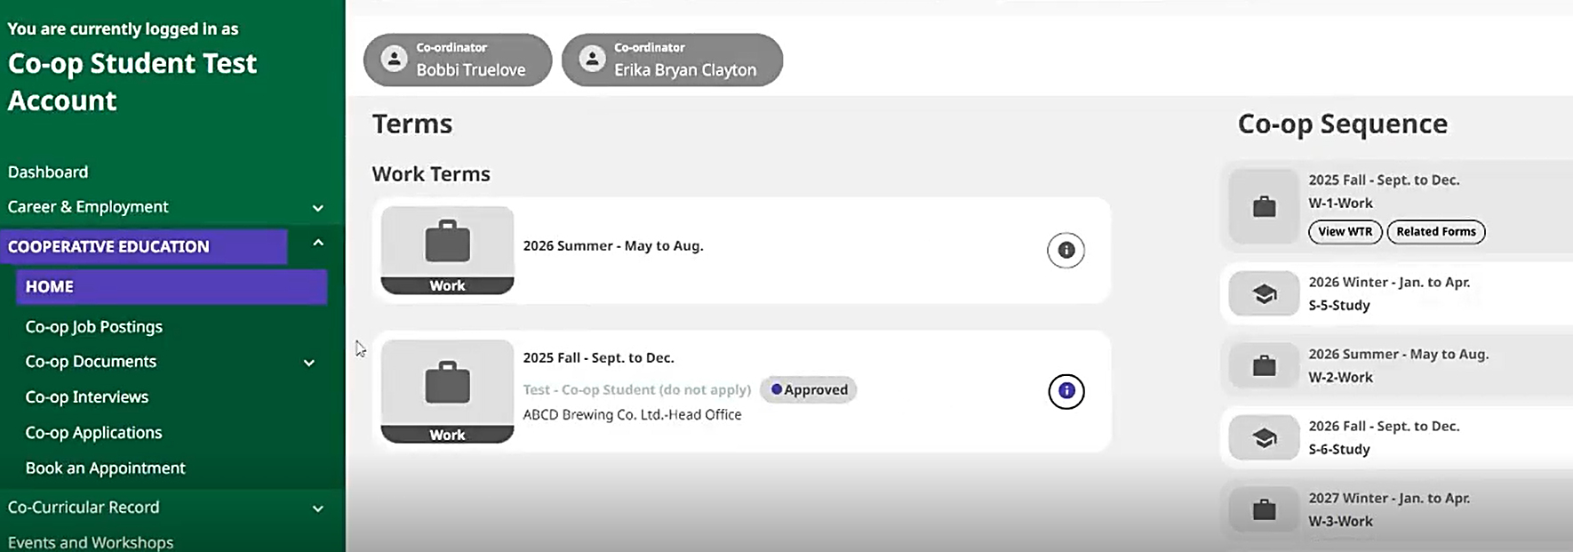
Rankings Page in HireAC
To accept the offer, click Accept and confirm your choice in the pop-up window that appears.
Once you accept a Co-op job offer, your work term record in the Cooperative Education Module will be automatically updated. To view it, go to the Home page.
You will also receive a notification email in HireAC confirming your offer acceptance. Please read this email carefully; it includes important reminders about Co-op terms and conditions, as well as key details such as the security screening process.
In addition, the employer will receive an automatic notification of your acceptance. They will typically contact you within 5 business days to discuss the next steps in the hiring process.

